Slide 1
Tutorial on Prompt Engineering and Metadata
Jian Qin and Bei Yu Syracuse University

Slide 2
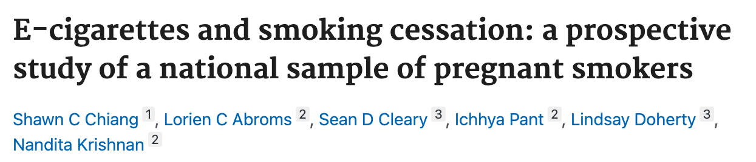
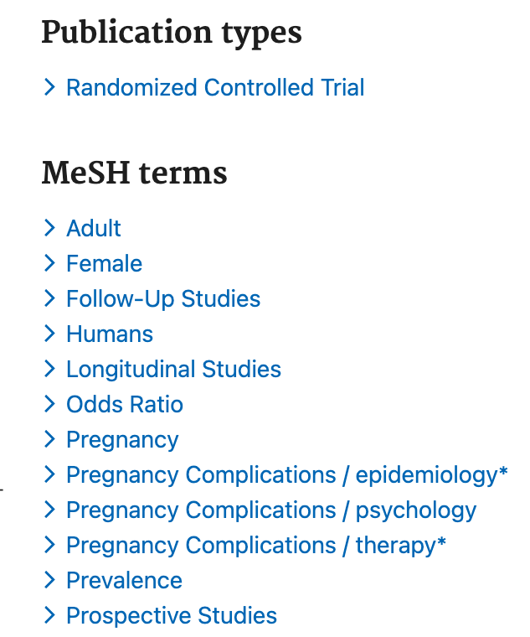
ML/NLP and Metadata
Machine Learning and Natural Language Processing techniques are often used for automatically extracting metadata from textual documents, e.g. metadata in PubMed
Metadata application - automated labeling for cataloging

Slide 3
Text classification is a common NLP task for creating metadata that need to be inferred from textual documents
Named-Entity Recognition (NER)
Sentence “The symptoms suggest a possible case of rheumatoid arthritis.”
NER tagging “O O O O O O O B-Disease I-Disease O”
Relation Extraction (RE)
Sentence “Smoking causes cancer”
Relation e1=“smoking”, e2=“cancer”, r= causal
Many other ad hoc classification tasks,
e.g. MeSH terms,
Publication Type – cohort, RCT, etc.?
Human study?

Slide 4

Part I – the evolving NLP methodology

Slide 5
The evolving NLP methodology
First-generation methods: rules and lexicons
E.g. keyword search for “randomized clinical trial”, or disease names, etc.
Second-generation methods: fully-supervised machine learning
Linear classifiers are popular text classifier, e.g. Naïve Bayes and SVMs
Strength
Interpretability – feature weights explain their salience for prediction
Challenges
Need a large amount of training data for sophisticated tasks
Need feature engineering to find most salient features for prediction

Slide 6
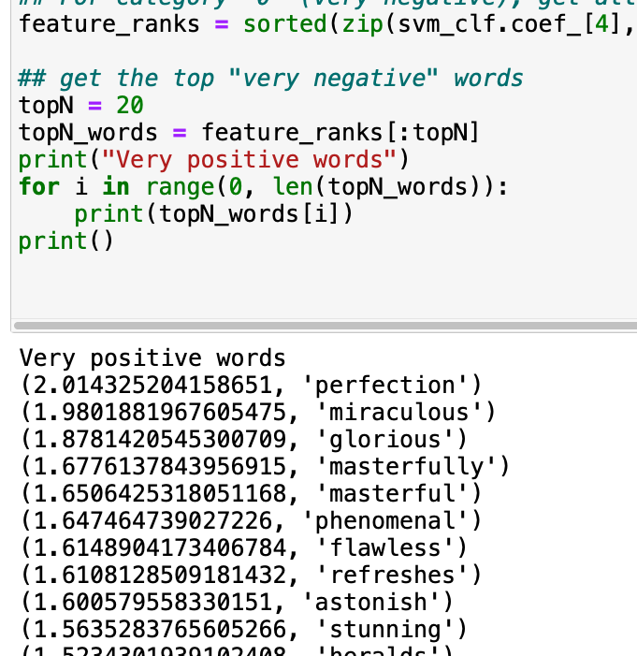
Fully-supervised learning
A task-specific model is trained on a task-specific data set.
These models often rely heavily on feature engineering, where researchers use their domain knowledge to select salient features from training data.

Slide 7
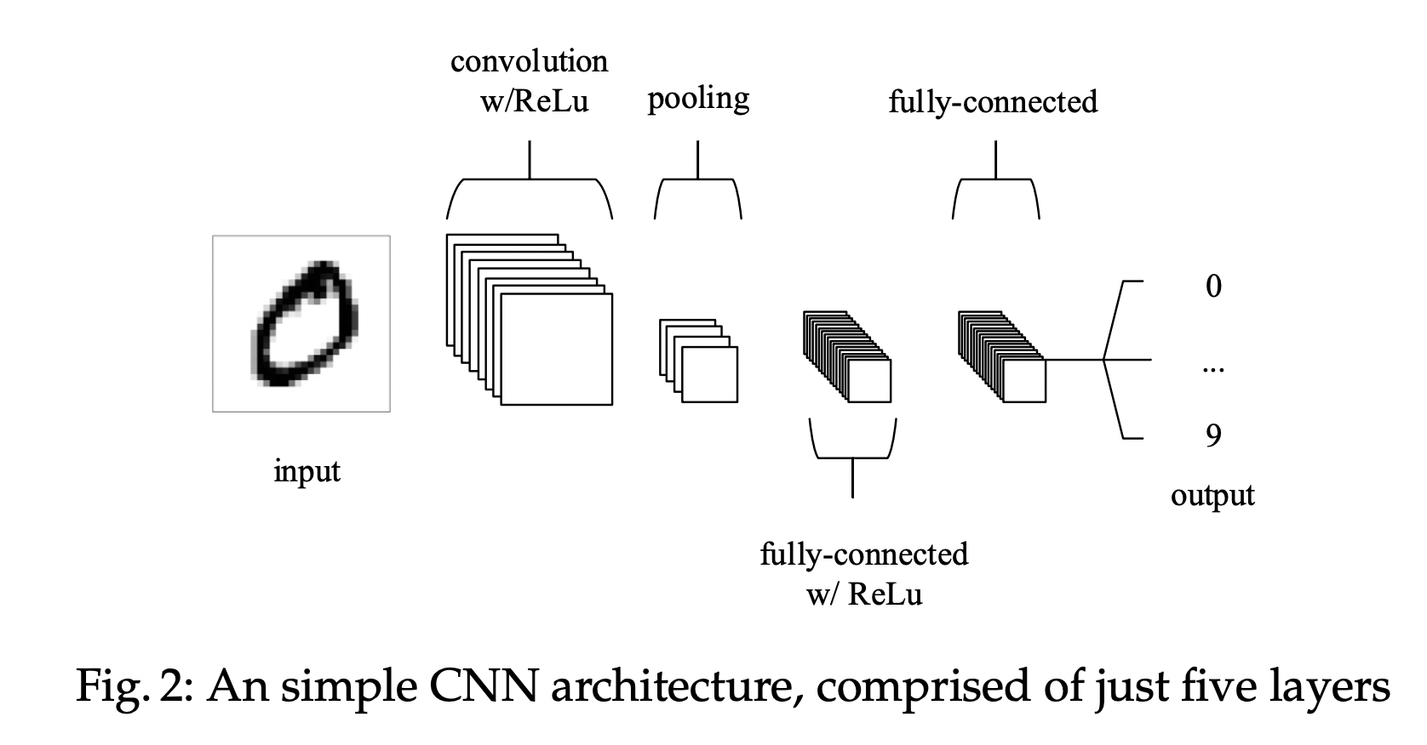
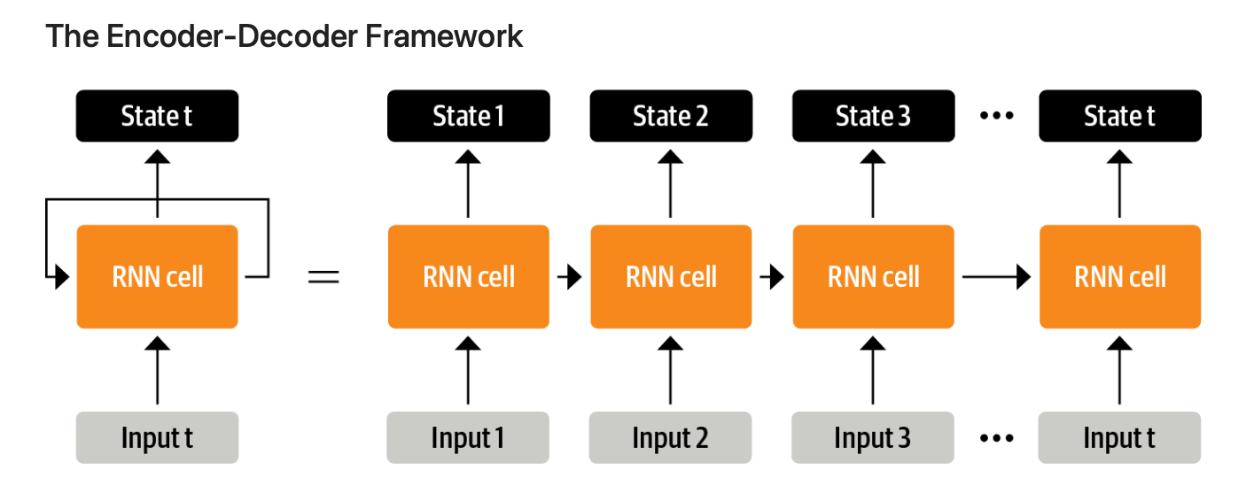
From feature engineering to architecture engineering
“With the advent of neural network models for NLP, salient features were learned jointly with the training of the model itself, and hence focus shifted to architecture engineering, where inductive bias was rather provided through the design of a suitable network architecture conducive to learning such features.”
“Early NLP models relied heavily on feature engineering, where researchers used their domain knowledge to define and extract salient features from raw data and provide models with the appropriate inductive bias to learn from the limited data.”
O'Shea, K., & Nash, R. (2015). An introduction to convolutional neural networks. arXiv preprint arXiv:1511.08458.
Tunstall, L., Von Werra, L., & Wolf, T. (2022). Natural language processing with transformers. " O'Reilly Media, Inc.".
Liu, P., Yuan, W., Fu, J., Jiang, Z., Hayashi, H., & Neubig, G. (2023). Pre-train, prompt, and predict: A systematic survey of prompting methods in natural language processing. ACM Computing Surveys, 55(9), 1-35.

Slide 8
Two ”Sea Changes”
First sea change - 2017-2019 shift from fully-supervised paradigm to pre-train and fine-tune paradigm
Language Models (LMs) are trained on large datasets, in the process learning robust general-purpose features of the language it is modeling.
Pre-trained LMs will then be adapted to different downstream tasks by introducing additional parameters and fine-tuning them using task-specific objective functions
Within this paradigm, the focus shifted to objective engineering.
Liu, P., Yuan, W., Fu, J., Jiang, Z., Hayashi, H., & Neubig, G. (2023). Pre-train, prompt, and predict: A systematic survey of prompting methods in natural language processing. ACM Computing Surveys, 55(9), 1-35.

Slide 9
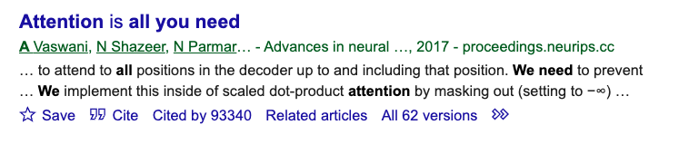
Hello Transformers
Neural networks before transformers
BERT was introduced in 2017
Single-layer perceptron
Multi-layer perceptron
Convolutional neural network
Transformer outperformed RNNs on machine translation tasks
Recursive neural network
Vaswani, A., Shazeer, N., Parmar, N., Uszkoreit, J., Jones, L., Gomez, A. N., ... & Polosukhin, I. (2017). Attention is all you need. Advances in neural information processing systems, 30.
Long short term memory (LSTM)

Slide 10
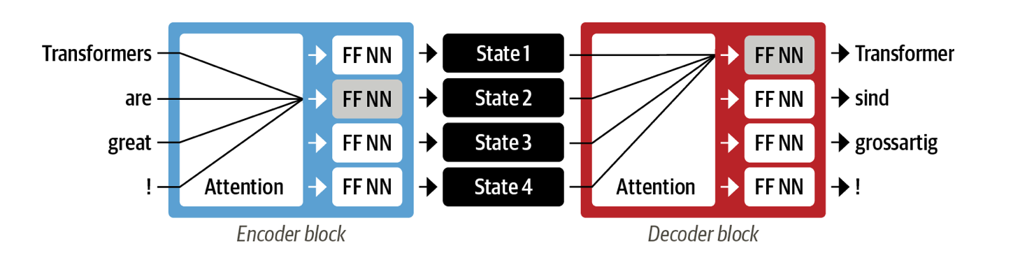
Transformer
FF NN: feed-forward neural network
Base BERT model has 12 attention layers
With the transformers, a new modeling paradigm was introduced: dispense with recurrent altogether, and instead rely entirely on a special form of attention called self-attention, which allows attention to operate on all the states in the same layer of the neural network.
This architecture can be trained much faster than recurrent models and paved the way for many of the recent breakthroughs in NLP.

Slide 11
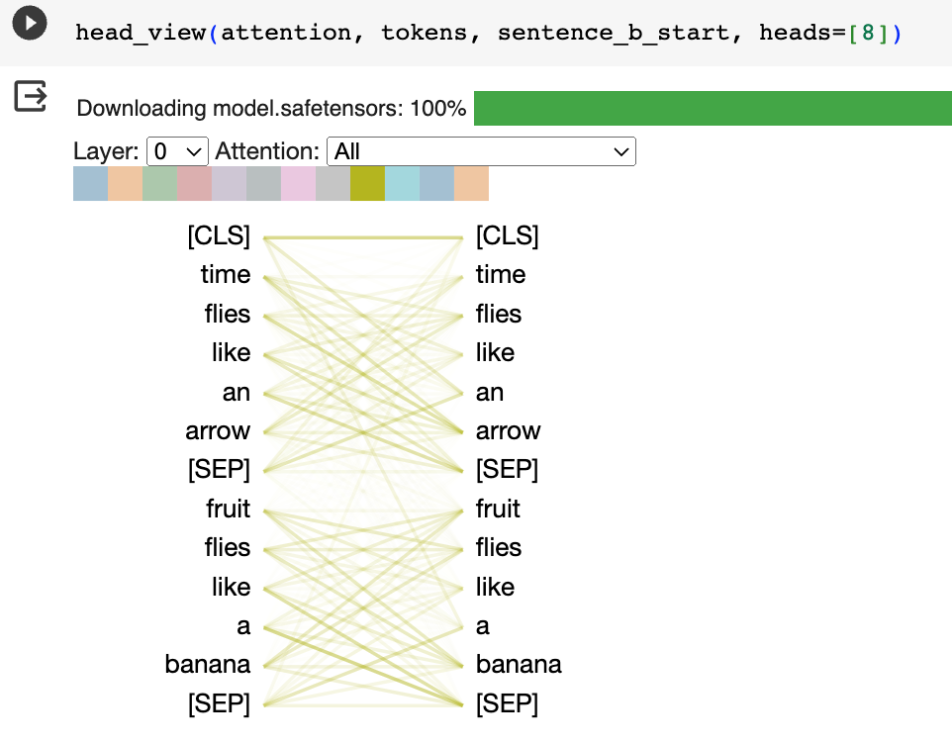
Attention mechanism

Slide 12
Transfer learning in NLP
Fully supervised machine learning task often requires a large amount of training data, which can be difficult to obtain.
It is also difficult to adapt a model trained in one domain (e.g. movie reviews) to another domain (e.g. book reviews)

Slide 13
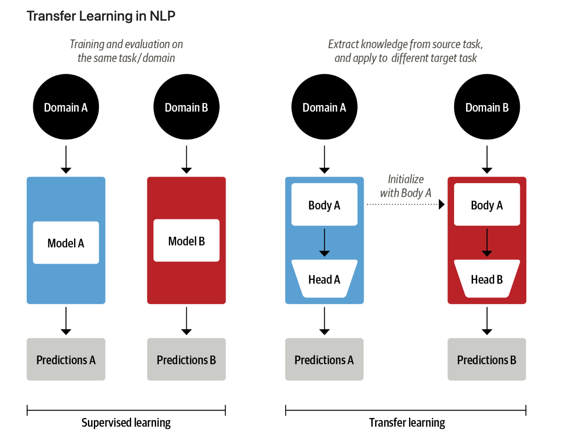

Slide 14
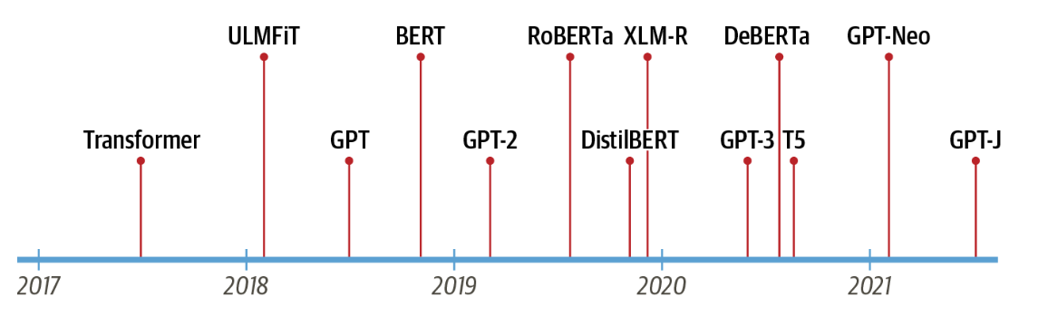
Transformers
GPT and BERT set a new state of the art across a variety of NLP benchmarks and ushered in the age of transformers
GPT – uses the decoder only
BERT – uses the encoder only

Slide 15
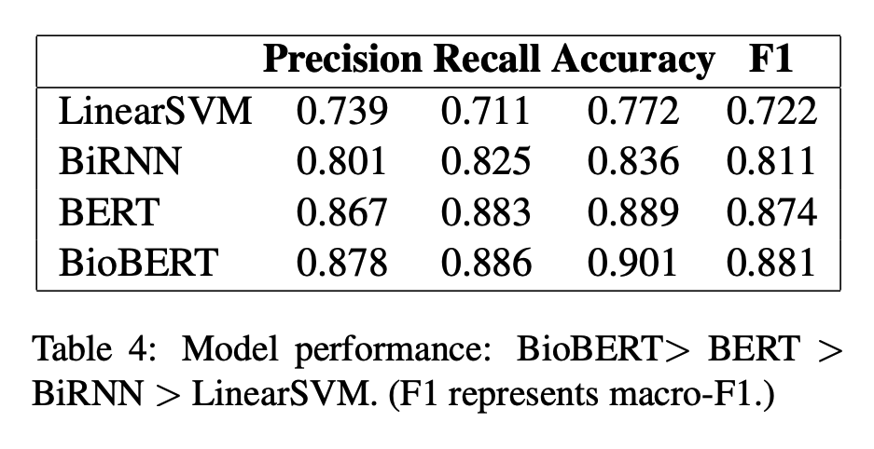
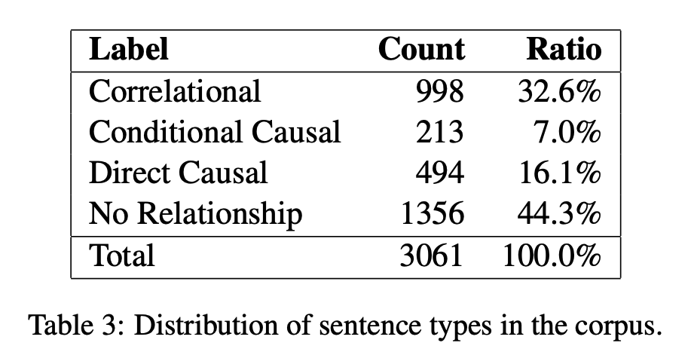
Fine-tune transformers
E.g. fine-tune BERT and BioBERT for identifying causal claims in research findings.
Yu, B., Li, Y., & Wang, J. (2019). Detecting causal language use in science findings. EMNLP-IJCNLP (pp. 4664-4674).

Slide 16
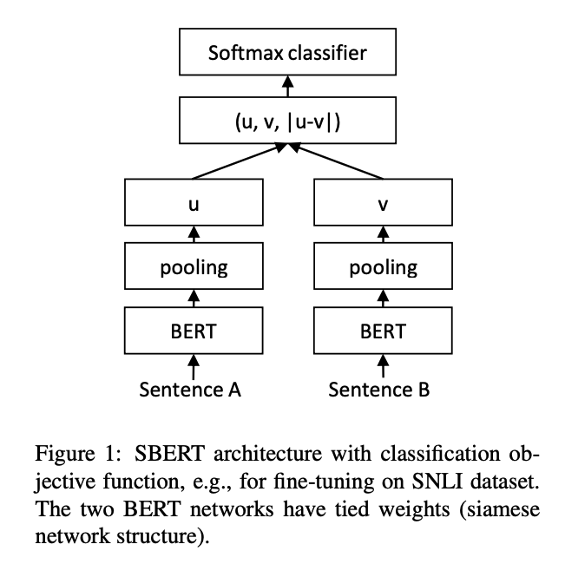
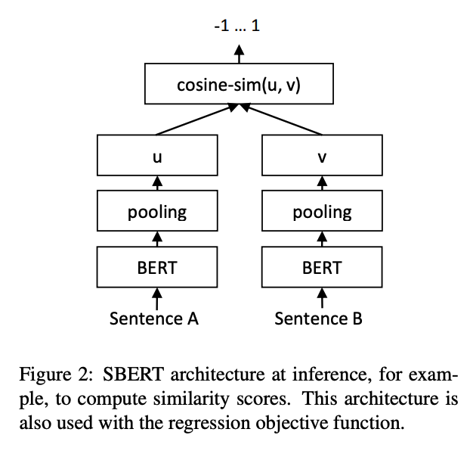
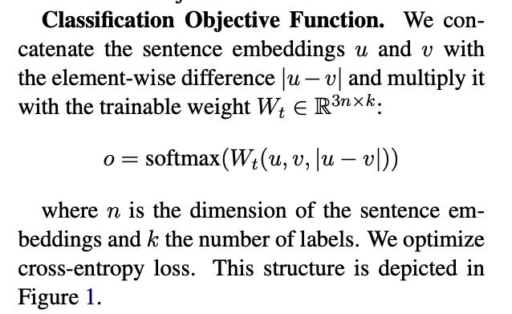
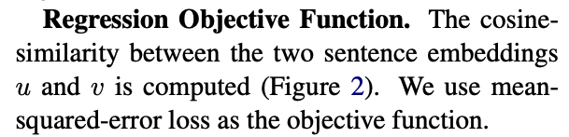
Sentence-BERT
Reimers, N., & Gurevych, I. (2019). Sentence-bert: Sentence embeddings using siamese bert-networks. arXiv preprint arXiv:1908.10084.

Slide 17
Training task – Semantic Textual Similarity
“We train SBERT on the combination of the SNLI (Bowman et al., 2015) and the Multi-Genre NLI (Williams et al., 2018) dataset. The SNLI is a collection of 570,000 sentence pairs annotated with the labels contradiction, entailment, and neutral. MultiNLI contains 430,000 sentence pairs and covers a range of genres of spoken and written text.”
Premise | Hypothesis | label
His favorite color is blue. | He is into heavy metal music | Neutral
She finds the joke hilarious. | She thinks the joke is not funny at all. | contradiction
The house was recently built. | The house is new. | entailment

Slide 18
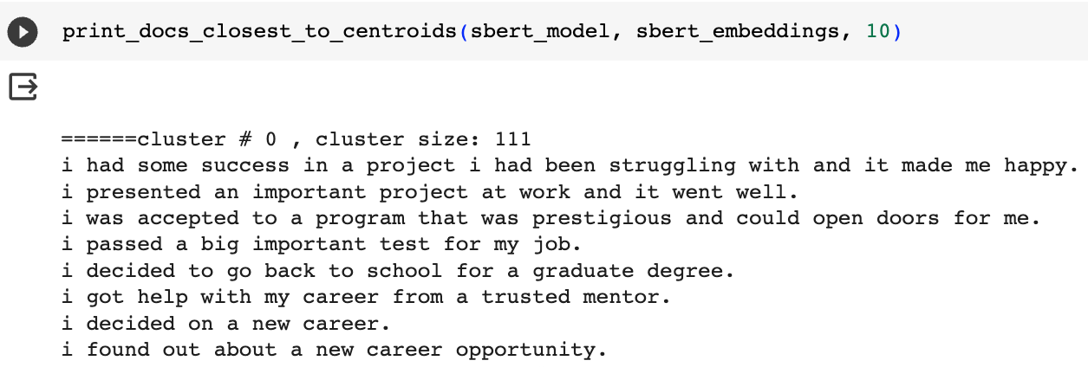
Sentence-BERT
Pre-trained sentence embedding models can then be used for classification and clustering tasks
E.g. clustering happy moments

Slide 19
“Second sea change”
Pre-train and fine-tune -> pre-train, prompt and predict
In this paradigm, instead of adapting pre-trained LMs to downstream tasks via objective engineering, downstream tasks are reformulated to look more like those solved during the original LM training with the help of a textual prompt.
E.g. task: identify the emotion of a social media post “I missed the bus today”
prompt: “I missed the bus today. I felt so”
Or task: translate English to French
Prompt: “English: I missed the bus today. French: ”
This method introduces the necessity for prompt engineering, finding the most appropriate prompt to allow a LM to solve the task at hand

Slide 20
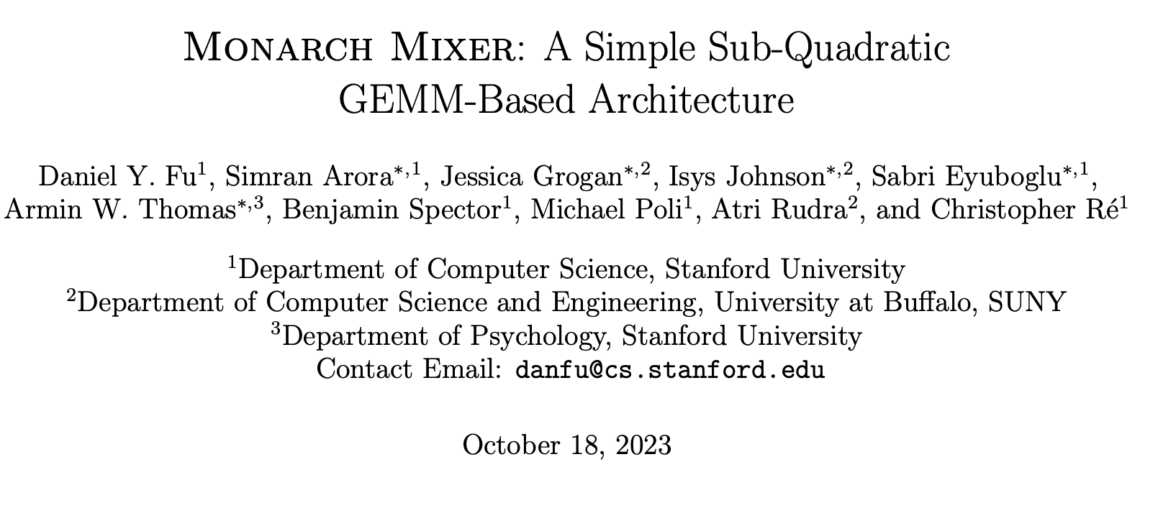
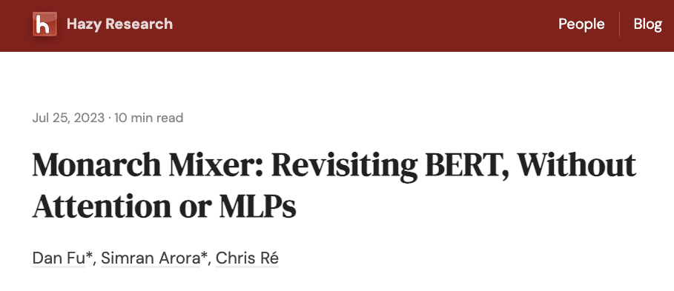

Are transformers the only way to get this amazing performance?
Alternative approach for building LLMs more efficiently without attention and MLPs?
Fu, D. Y., Arora, S., Grogan, J., Johnson, I., Eyuboglu, S., Thomas, A. W., ... & Ré, C. (2023). Monarch Mixer: A Simple Sub-Quadratic GEMM-Based Architecture. arXiv preprint arXiv:2310.12109.

Slide 21
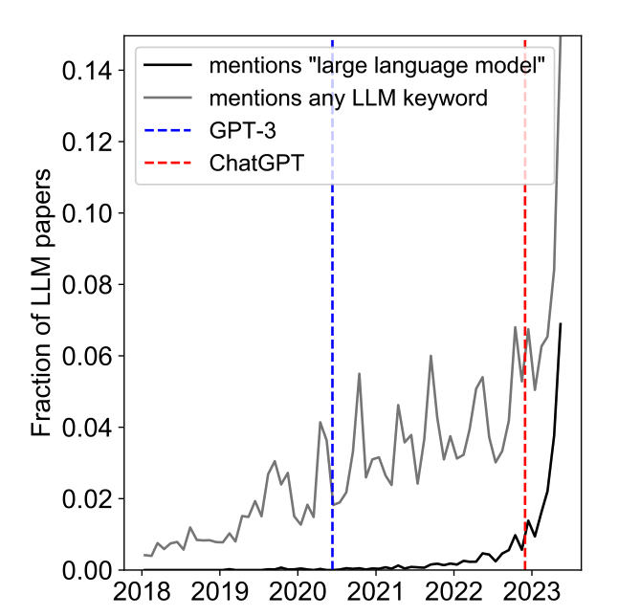
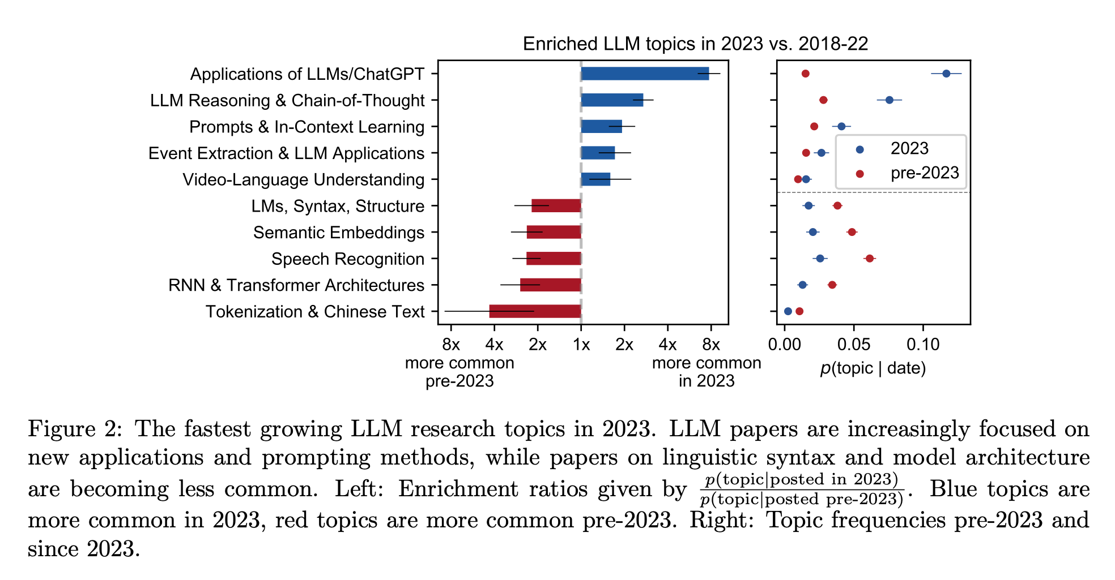
Topic Modeling of Arxiv Papers on LMs
Movva, R., Balachandar, S., Peng, K., Agostini, G., Garg, N., & Pierson, E. (2023). Large language models shape and are shaped by society: A survey of arXiv publication patterns. arXiv preprint arXiv:2307.10700.

Slide 22
Discussion
NLP methods that you have used for metadata extraction/generation?

Slide 23
Part II – Prompt Engineering Strategies

Slide 24
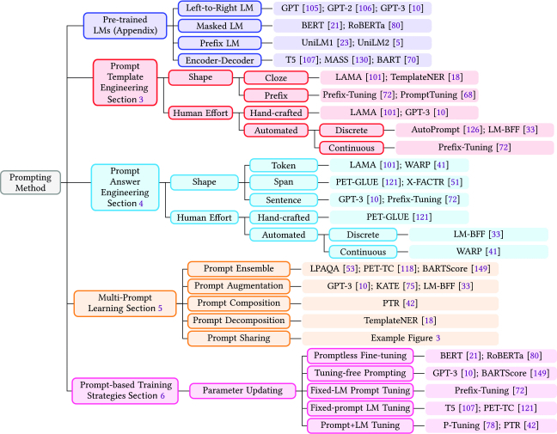
Typology of prompting methods
Liu, P., Yuan, W., Fu, J., Jiang, Z., Hayashi, H., & Neubig, G. (2023). Pre-train, prompt, and predict: A systematic survey of prompting methods in natural language processing. ACM Computing Surveys, 55(9), 1-35.

Slide 25
Prompt engineering strategies for text classification
A few commonly used strategies
Zero shot
Filled mask
instruction
In-context learning / few shots
Chain-of-thought

Slide 26
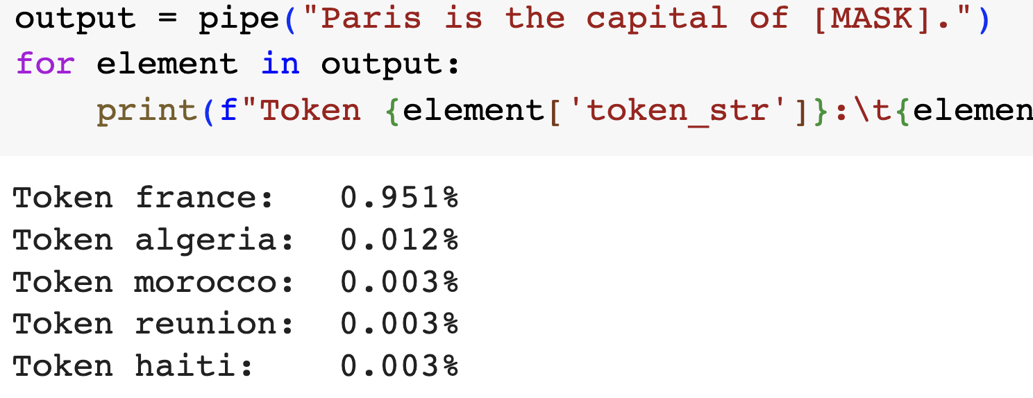
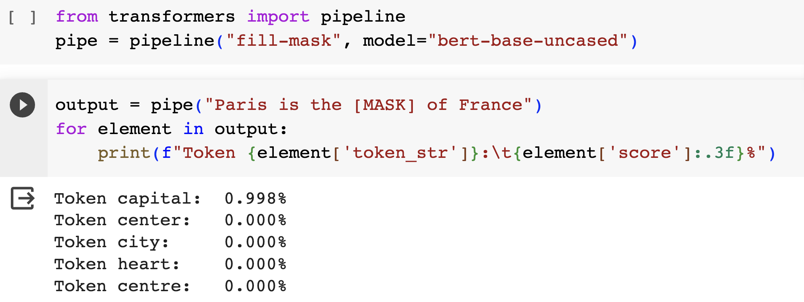
Zero-shot classification with filled mask
Language models like BERT are pretrained to predict masked tokens in text on thousands of books and large Wikipedia dumps.
To successfully predict a missing token, the model needs to be aware of the topic in the context.
We can try trick the model into classifying a document for us by providing a sentence like “this section was about the topic [MASK].”

Slide 27
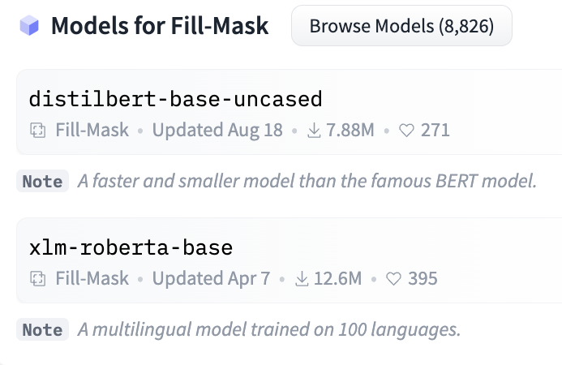
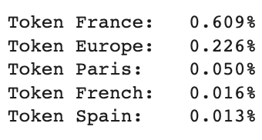
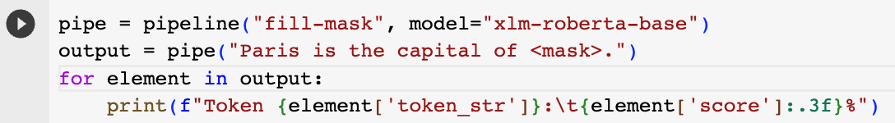
Models for fill-mask

Slide 28
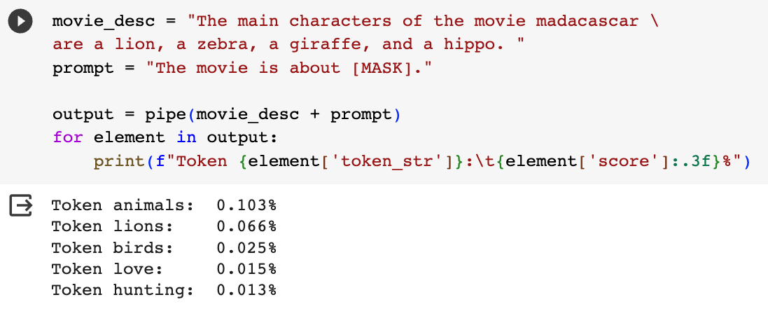
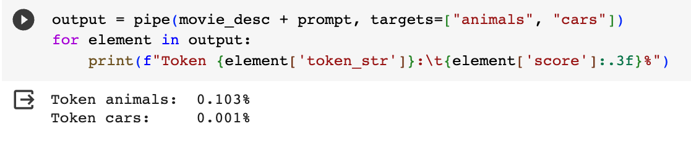
Filled-mask for topic classification

Slide 29
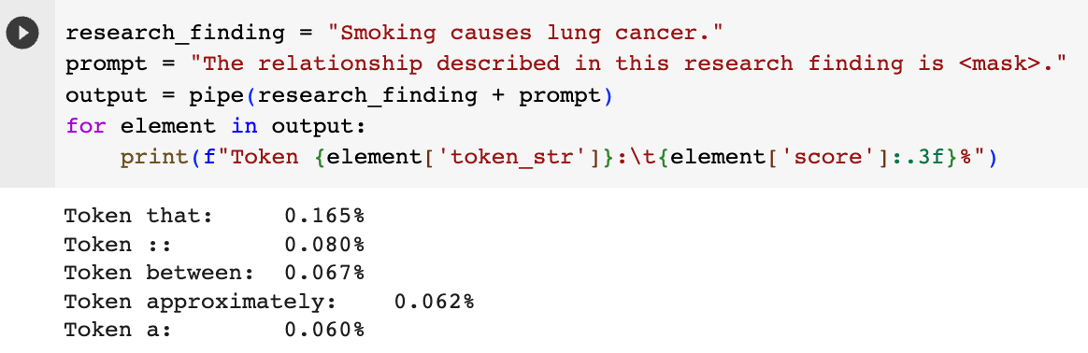
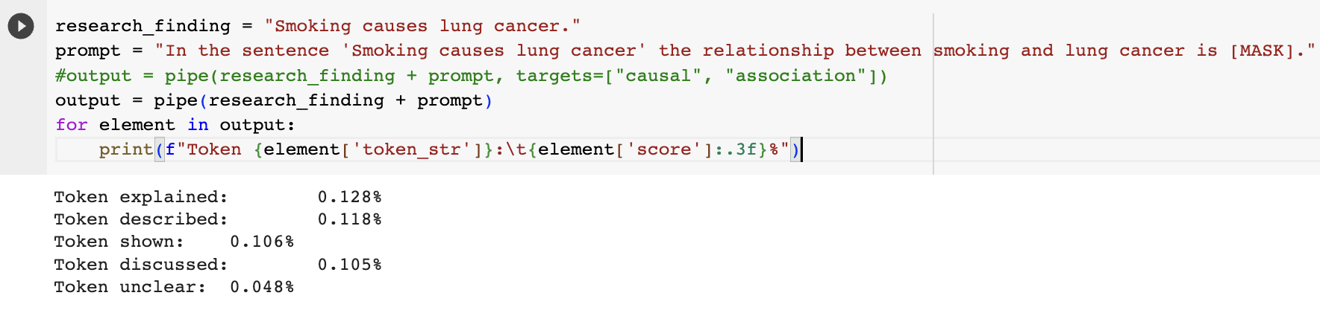
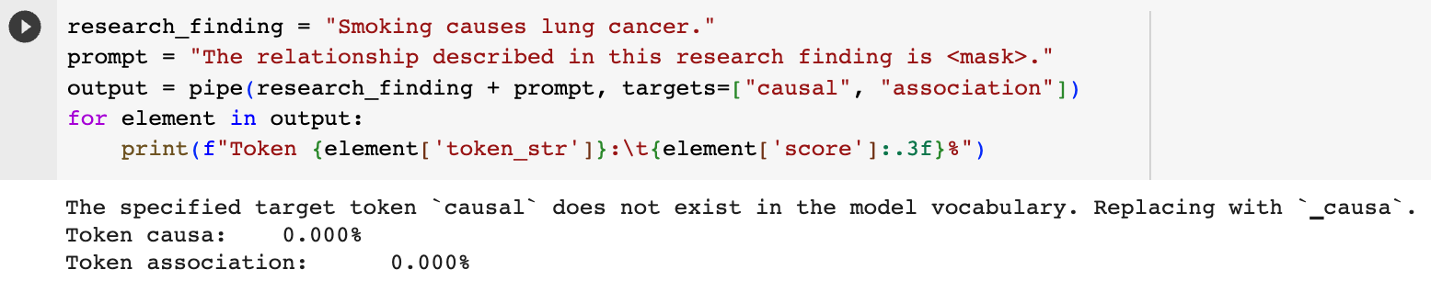
A challenging task

Slide 30
Adapt a model that has been trained on a task closer to classification: natural language inference (NLI)
For example, text entailment is a task to determine whether two text passages are likely to follow or contradict each other.
Models are typically trained to detect entailments and contradictions with datasets such as Multi-Genre NLI Corpus or Cross-Lingual NLI Corpus.
Each sample in these datasets is composed of three parts: a premise, a hypothesis, and a label, which can be one of entailment (hypothesis is true), contradiction (hypothesis is false) , or neutral (neither)
Premise | Hypothesis | label
His favorite color is blue. | He is into heavy metal music | Neutral
She finds the joke hilarious. | She thinks the joke is not funny at all. | contradiction
The house was recently built. | The house is new. | entailment

Slide 31
We can hijack a model trained on the MNLI dataset to build a zero-shot classifier
Premise = [the text to classify]
Hypothesis = “This example is about {label}”.
The entailment score tells us how likely the premise is about that topic
Run this for each class label sequentially.
Suitable for multi-label classification too.
Challenge : the choice of label names can have a large impact on the accuracy.

Slide 32
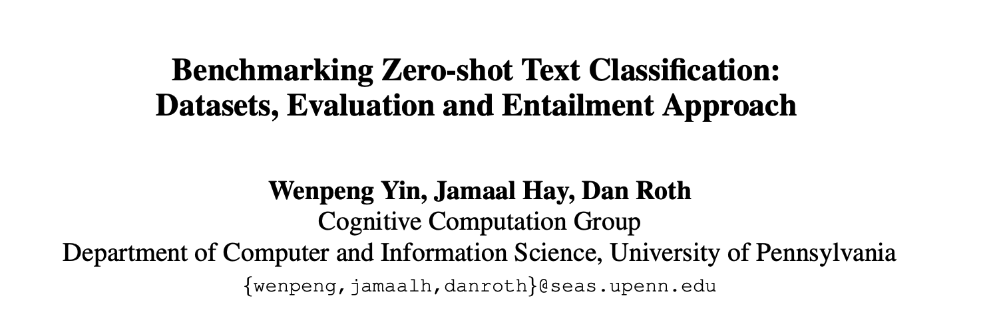
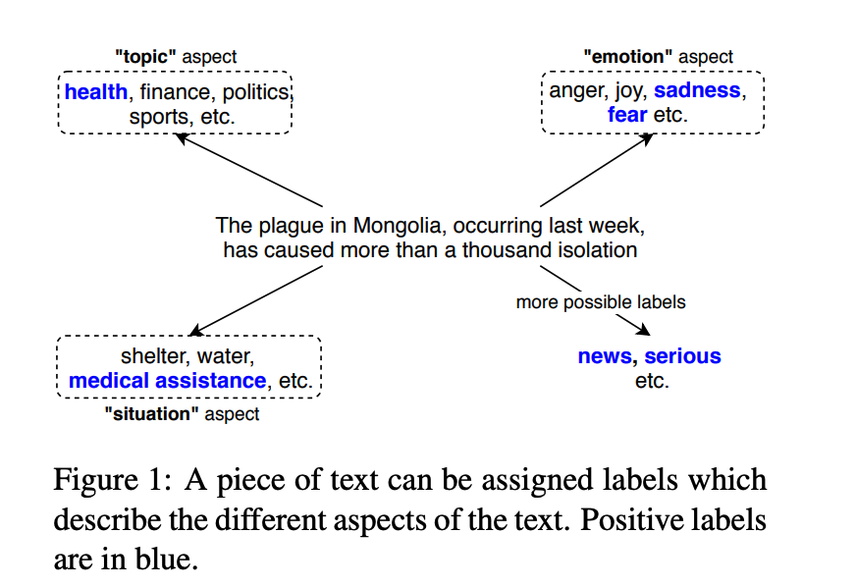
Zero-shot text classification
“In this work, we propose to treat 0SHOT-TC as a textual entailment problem. This is to imitate how humans decide the truth value of labels from any aspects. Usually, humans understand the problem described by the aspect and the meaning of the label candidates. Then humans mentally construct a hypothesis by filling a label candidate, e.g., “sports”, into the aspect-defined problem “the text is about ?”, and ask ourselves if this hypothesis is true, given the text.”
Yin, W., Hay, J., & Roth, D. (2019, November). Benchmarking Zero-shot Text Classification: Datasets, Evaluation and Entailment Approach. In Proceedings of the 2019 Conference on Empirical Methods in Natural Language Processing and the 9th International Joint Conference on Natural Language Processing (EMNLP-IJCNLP) (pp. 3914-3923).

Slide 33
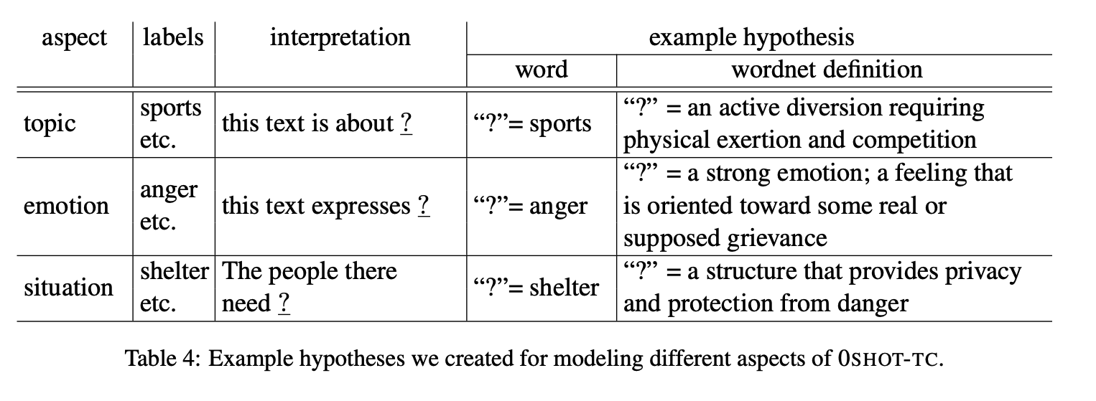
Text classification task modeled as an entailment task

Slide 34
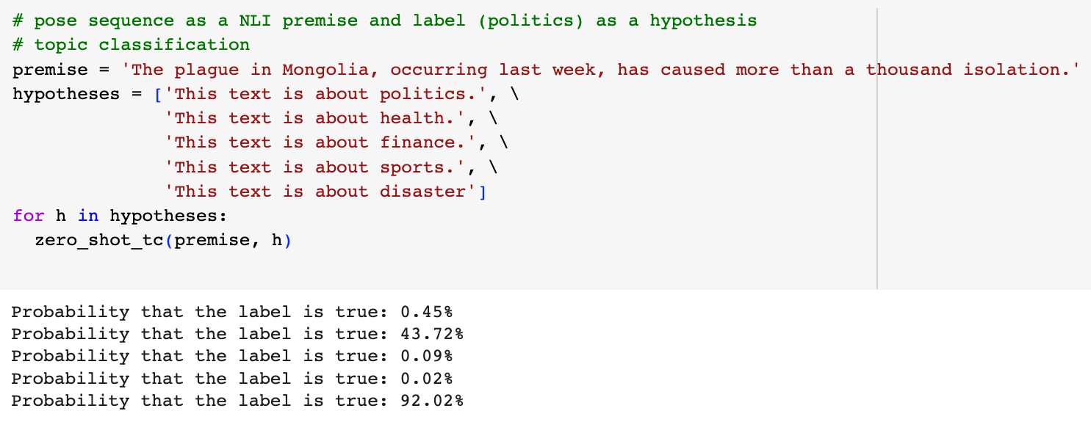
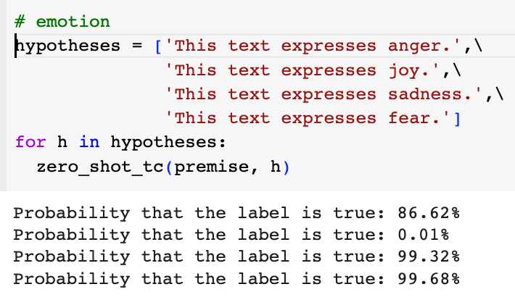
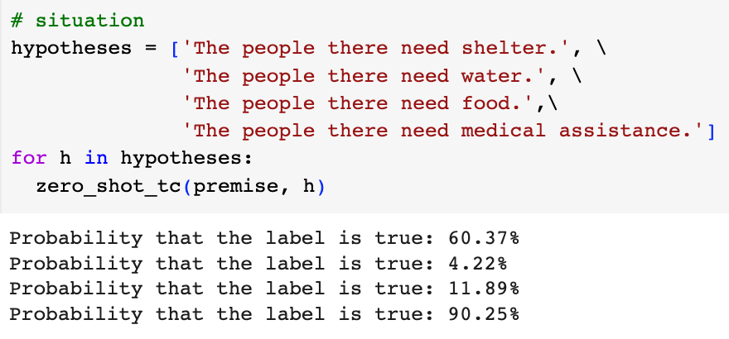
Code adapted from https://joeddav.github.io/blog/2020/05/29/ZSL.html

Slide 35
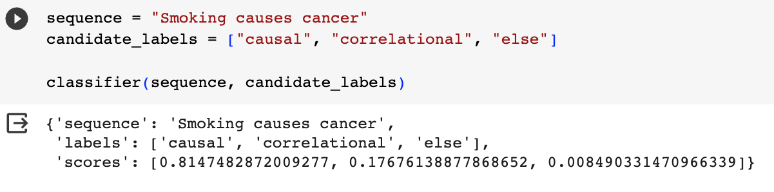
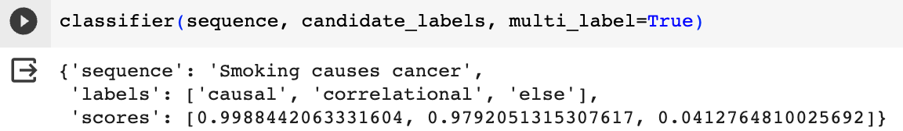
Huggingface zero shot classification pipeline

Slide 36
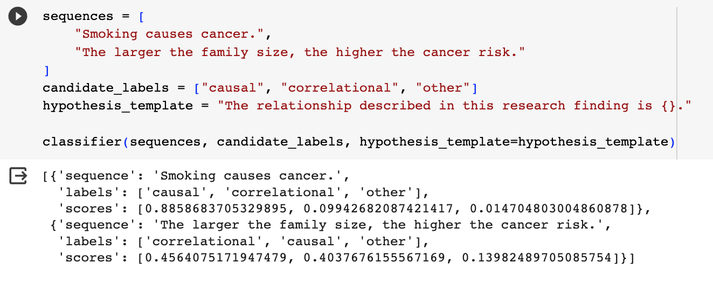
Change hypothesis_template
Bias in LLM?

Slide 37
Discussion
Any metadata applications that could use the zero-shot BERT or BART approach?

Slide 38
Prompt engineering with ChatGPT
Left-to-right language models (autoregressive)
Manually create a prompt based on templates
Add context and background
Ask ChatGPT to generate prompt and adapt
Add Chain-of-thought (CoT)
Add few-shot examples

Slide 39
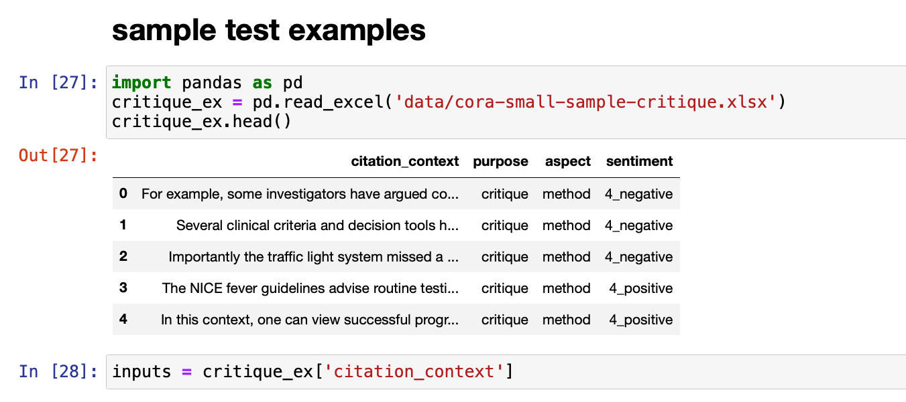
Case study - Use chatGPT to identify “Critique” Citations?
Can GPT-4 identify a “critique” citation where an author [Opinion Holder] expressed opinion toward the cited paper [Target of Opinion] or quoted someone else’s opinion [Opinion Holder] toward the cited paper [Target of Opinion].
”Critique” citations are relatively rare, compared to other types of citations, since researchers prefer objective vs. subjective writing. They appear more often in review papers.
Traditional machine learning methods that we tried had difficulty identifying Critique citations.
Small test set: 10 critique citations (manually annotated)
Measure: Recall (how many critiques are identified?)
Approach: zero-shot prompts

Slide 40
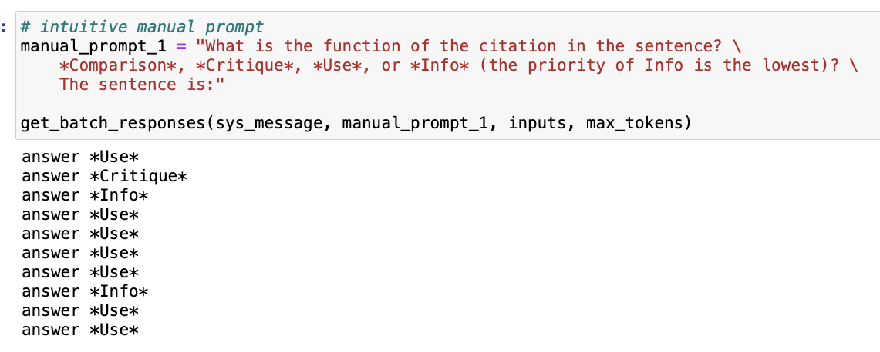
Manual Prompt #1 Question-answer style prompt

Slide 41
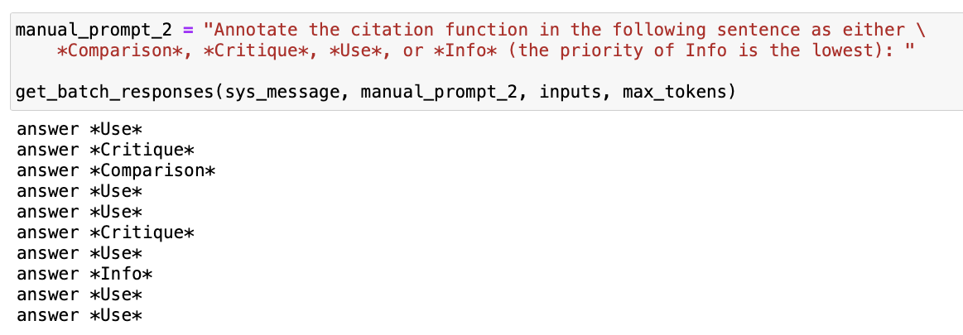
Manual Prompt #2 Instruction-style prompt

Slide 42
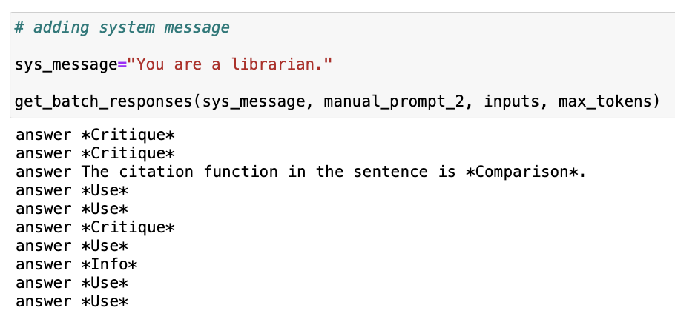
Add persona-style system message

Slide 43
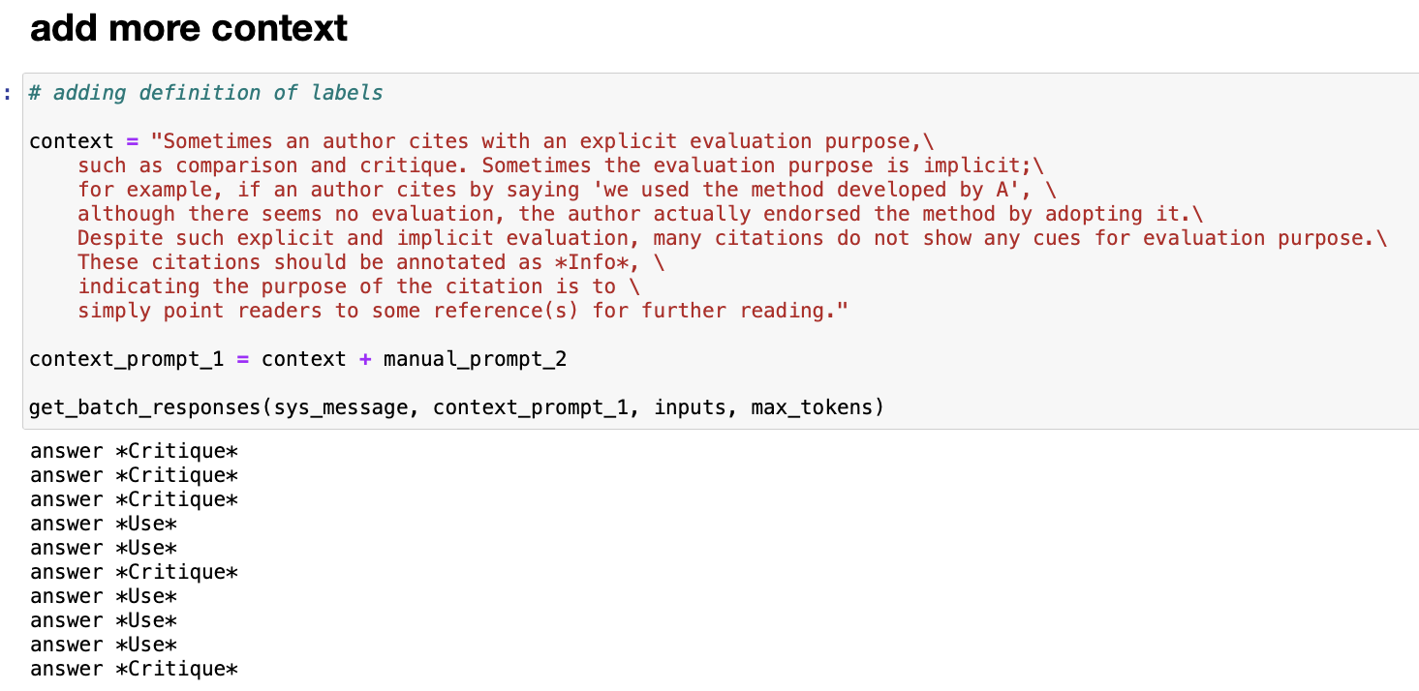
Add more context

Slide 44
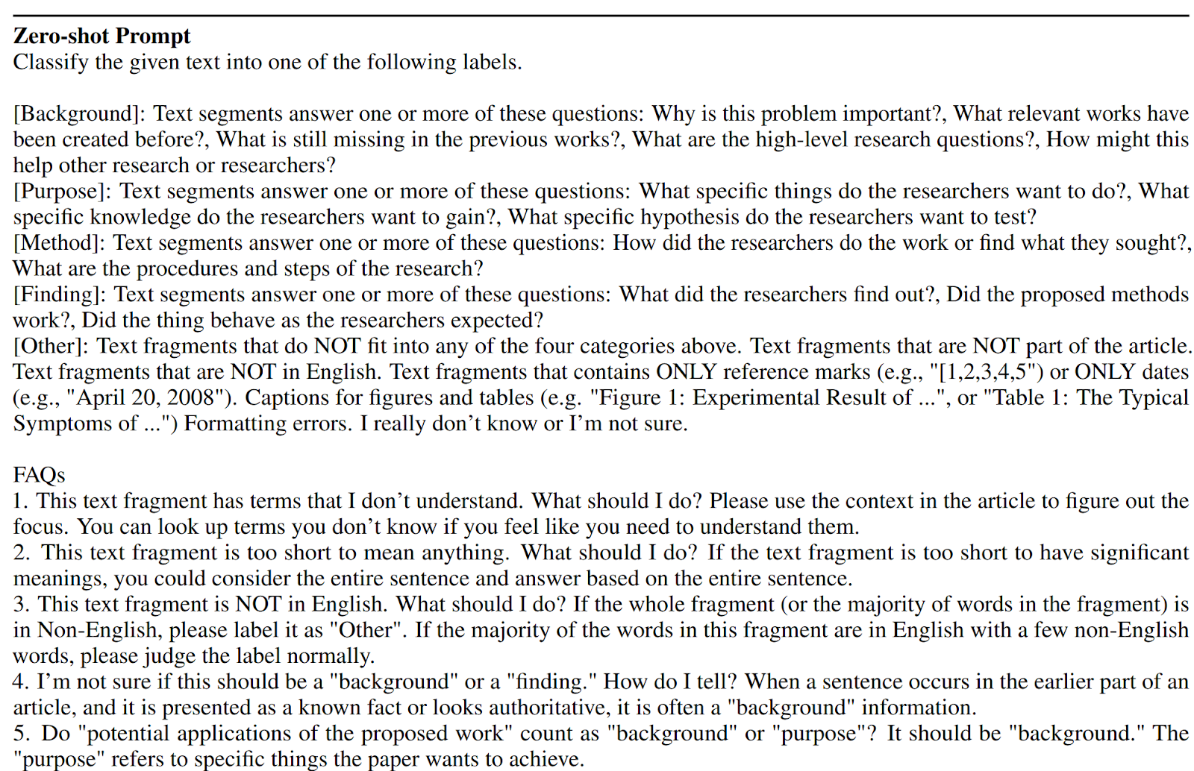
Adding FAQs as context

Slide 45
Chain-of-thought (CoT)
“Let's think step by step” (Wei et al., 2022).
Mainly used in reasoning tasks (Qiao et al., 2022).
It also is broadly used in classification tasks, for example, “Answer (yes or no) the question step by step” (Zhong et al., 2023).
Changing the wording in CoT can also impact the results (Kim et al., 2023).
A survey paper about CoT: https://proceedings.neurips.cc/paper_files/paper/2022/hash/9d5609613524ecf4f15af0f7b31abca4-Abstract-Conference.html

Slide 46
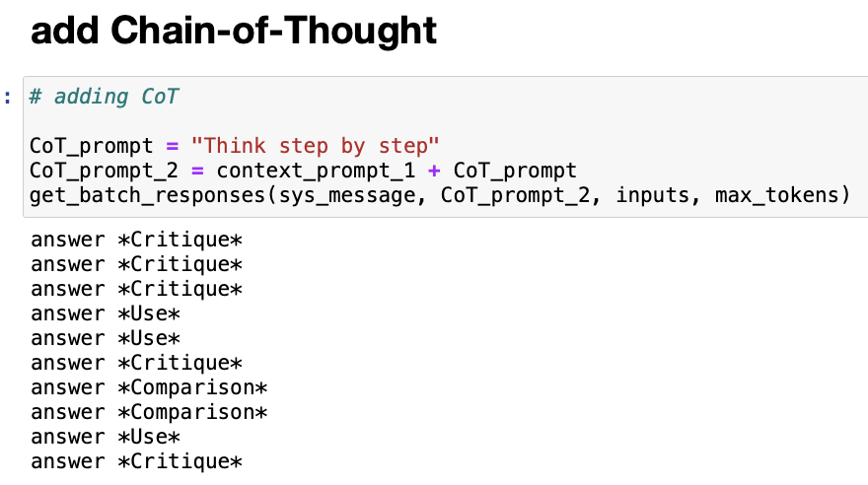
Add Chain-of-Thought

Slide 47
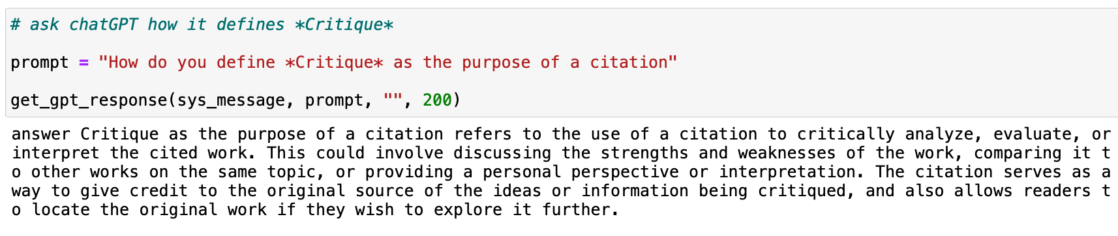
Ask GPT-4 how it defines Critique citations

Slide 48
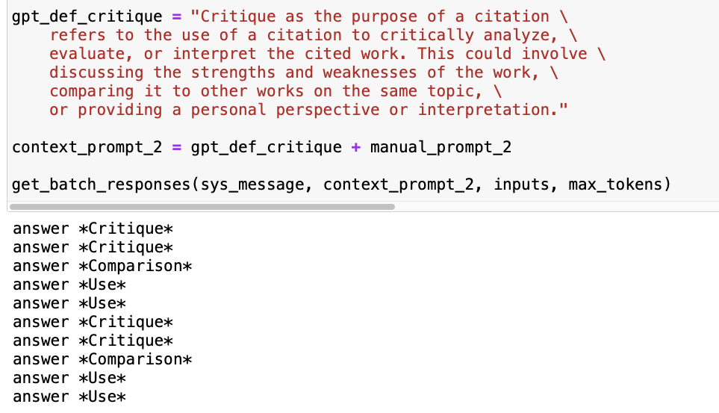
Use GPT-4 definition as prompt

Slide 49

Adapt GPT4 definition
Remove the sentence related to *comparison* citation

Slide 50
Prompt performance comparison
GPT4-Prediction | Manual #1 | Manual #2 | Sys msg | More context | CoT | GPT4 def | Adjusted GPT4 def
Critique | 1 | 2 | 3 | 5 | 5 | 4 | 4
Comparison | 0 | 1 | 1 | 0 | 2 | 2 | 1
Use | 7 | 6 | 5 | 5 | 3 | 4 | 5
Info | 2 | 1 | 1 | 0 | 0 | 0 | 0
Total | 10 | 10 | 10 | 10 | 10 | 10 | 10

Slide 51
Prompt performance comparison same prompts tested one week ago
GPT4-Prediction | Manual #1 | Manual #2 | Sys msg | More context | CoT | GPT4 def | Adjusted GPT4 def
Critique | 1 | 2 | 3 | 4 | 4 | 4 | 4
Comparison | 0 | 1 | 1 | 2 | 2 | 1 | 1
Use | 5 | 7 | 6 | 3 | 3 | 5 | 4
Info | 4 | 0 | 0 | 1 | 1 | 0 | 0
Total | 10 | 10 | 10 | 10 | 10 | 10 | 9

Slide 52
Few-shot learning (Brown et al., 2020)
zero-shot
﻿What is the function of the citation in the sentence: {citation_context}?
one-shot
﻿What is the function of the citation in the sentence?
The candidate feature templates include : Voice from Sun and Jurafsky (2004) .
Intent: Use.
{citation_context}"
few-shot
﻿What is the function of the citation in the sentence?
The candidate feature templates include : Voice from Sun and Jurafsky (2004) .
Intent: Use.
This is a similar conclusion to our previous work in Salloum and Habash (2011).
Intent: Compare Or Contrast
{citation_context}"

Slide 53
Strategies for selecting few-shot examples
The selection of specific examples can significantly impact the accuracy of the language model (Zhao et al., 2021).
Random sampling (Sun et al., 2023)
kNN sampling (Khandelwal et al., 2020; Yu et al., 2023)
kNN cluster the training data
Select representative words in each cluster
Select sentences with the most representative words from training data
Sun, X., Li, X., Li, J., Wu, F., Guo, S., Zhang, T., & Wang, G. (2023). Text Classification via Large Language Models. arXiv preprint arXiv:2305.08377.
Zhao, Z., Wallace, E., Feng, S., Klein, D., & Singh, S. (2021, July). Calibrate before use: Improving few-shot performance of language models. In International Conference on Machine Learning (pp. 12697-12706). PMLR.
Yu, F., Quartey, L., & Schilder, F. (2023, July). Exploring the Effectiveness of Prompt Engineering for Legal Reasoning Tasks. In Findings of the Association for Computational Linguistics: ACL 2023 (pp. 13582-13596).
Khandelwal, U., Fan, A., Jurafsky, D., Zettlemoyer, L., & Lewis, M. (2020). Nearest neighbor machine translation. arXiv preprint arXiv:2010.00710.

Slide 54
Discussion
Metadata applications that can directly prompt chatGPT for solutions?

Slide 55

Part III Prompt Engineering – Science or Alchemy?

Slide 56
Systematic evaluation of prompt-engineering strategies
Case studies on single NLP tasks
Evaluations on multiple NLP tasks
Investigations on bias in LLM responses to prompts
Note that many studies are posted to Arxiv, being cited without peer review

Slide 57
Case study - How does ChatGPT understand causal language in science findings?
Compare chatGPT and fine-tuned BERT model in identifying causal language in science claims
Models: GPT (text-davinci-003) and chatGPT (gpt-3.5-turbo)
Dev set: 200 sample sentences for prompt engineering
Test set: 3,061 sentences from PubMed abstracts and 2,076 sentences from EurekAlert! press releases
Kim, Y., Guo, L., Yu, B., & Li, Y. (2023, July). Can ChatGPT Understand Causal Language in Science Claims?. In Proceedings of the 13th Workshop on Computational Approaches to Subjectivity, Sentiment, & Social Media Analysis (pp. 379-389).

Slide 58

Prompt engineering

Slide 59

Prompt engineering

Slide 60

Results

Slide 61

Results

Slide 62


Results

Slide 63



Results

Slide 64
ChatGPT for genre classification
Huang, F., Kwak, H., & An, J. (2023). Is chatgpt better than human annotators? potential and limitations of chatgpt in explaining implicit hate speech. arXiv preprint arXiv:2302.07736.
“ChatGPT correctly identifies 80% of the implicit hateful tweets.”
“For those 20% disagreement cases, ChatGPT’s results are more likely to align with lay people’s perceptions. ”
“ChatGPT-generated NLEs can reinforce human perception, and they tend to be perceived as clearer than human-written NLEs. These results pose an important question. Since ChatGPT can be convincing, its capability would become a risk of misleading lay people if its decision is wrong. This highlights that it would require extra caution when using ChatGPT as a tool for assisting data annotation.”

Slide 65
ChatGPT for genre classification
Kuzman, T., Ljubešić, N., & Mozetič, I. (2023). Chatgpt: beginning of an end of manual annotation? Use case of automatic genre identification. arXiv preprint arXiv:2303.03953.
“We compare ChatGPT with a multilingual XLM-RoBERTa language model that was fine-tuned on datasets, manually annotated with genres. The models are compared on test sets in two languages: English and Slovenian.”
“ChatGPT outperforms the fine-tuned model when applied to the dataset which was not seen before by either of the models.”
“However, if the model is fully prompted in Slovenian, the performance drops significantly, showing the current limitations of ChatGPT usage on smaller languages.”

Slide 66
ChatGPT evaluation on multiple NLP tasks
Qin, C., Zhang, A., Zhang, Z., Chen, J., Yasunaga, M., & Yang, D. (2023). Is ChatGPT a general-purpose natural language processing task solver?. arXiv preprint arXiv:2302.06476.
“Zero-shot learning ability of ChatGPT by evaluating it on 20 popular NLP datasets covering 7 representative task categories. “
“ChatGPT performs well on many tasks favoring reasoning capabilities (e.g., arithmetic reasoning) while it still faces challenges when solving specific tasks such as sequence tagging.”

Slide 67
Jack of all trades, master of none?
Kocoń, J., Cichecki, I., Kaszyca, O., Kochanek, M., Szydło, D., Baran, J., ... & Kazienko, P. (2023). ChatGPT: Jack of all trades, master of none. Information Fusion, 101861.
Based on ChatGPT’s responses to 48k+ prompts related to 25 different NLP tasks, most of them subjective even to humans, such as sentiment analysis, emotion recognition, offensiveness, and stance detection. In contrast, the other tasks require more objective reasoning like word sense disambiguation, linguistic acceptability, and question answering.
ChatGPT loses to the best models currently available (SOTA), from 4 to over 70%.
Its loss is relatively greater for more difficult and pragmatic tasks, especially when evaluating emotional texts. All this makes ChatGPT a master of none of the task.

Slide 68
Chain-of-Thought
“we show how such reasoning abilities emerge naturally in sufficiently large language models via a simple method called chain-ofthought prompting, where a few chain of thought demonstrations are provided as exemplars in prompting.”
“Experiments on three large language models show that chain-of-thought prompting improves performance on a range of arithmetic, commonsense, and symbolic reasoning tasks.”
Wei, J., Wang, X., Schuurmans, D., Bosma, M., Xia, F., Chi, E., ... & Zhou, D. (2022). Chain-of-thought prompting elicits reasoning in large language models. Advances in Neural Information Processing Systems, 35, 24824-24837.

Slide 69
Empirical studies on few-shot prompts

Slide 70

What Causes Instability in Few-shot Prompts?
GPT-3 - the choice of prompt format, training examples, and even the order of the training examples can cause accuracy to vary from near chance to near state-of-the-art.
we show that the variance arises because LMs are biased towards outputting answers that are (1) frequent in the prompt (majority label bias), (2) towards the end of the prompt (recency bias), and (3) common in the pre-training data (common token bias).
http://proceedings.mlr.press/v139/zhao21c/zhao21c.pdf

Slide 71

Majority Label Bias
“GPT-3 is biased towards answers that are frequent in the prompt. A trivial case is when a text classification prompt has a class imbalance, e.g., more Positive than Negative sentiment examples.”
“The majority label bias also explains why we frequently observe a drop in accuracy when moving from 0-shot to 1-shot—we found that the drop is due to the model frequently repeating the class of the one training example.”

Slide 72

Recency Bias
The model’s majority label bias is aggravated by its recency bias: the tendency to repeat answers that appear towards the end of the prompt. For instance, when two Negative examples appear at the end (P P N N), the model will heavily prefer the Negative class.
Moreover, the recency bias can outweigh the majority label bias, e.g., the “P P P N” training set leads to nearly 90% of predictions being Negative, despite 3 4 of the training examples being Positive.

Slide 73
Common Token Bias
GPT-3 is biased towards outputting tokens that are common in its pretraining distribution, which is likely suboptimal for the distribution of answers on the downstream task.
A simple case of this occurs for the LAMA fact retrieval dataset, where the model often predicts common entities such as “America” when the ground-truth answer is instead a rare entity.

Slide 74
Order of few-shot examples affects prompt performance
This phenomenon is present across model sizes, irrelevant to a specific subset of samples, and that a given good permutation for one model is not transferable to another.
Proposed solution based on GPT-3
“we use the generative nature of language models to construct an artificial development set and based on entropy statistics of the candidate permutations on this set, we identify performant prompts. Our method yields a 13% relative improvement for GPT-family models across eleven different established text classification tasks.”
Lu, Y., Bartolo, M., Moore, A., Riedel, S., & Stenetorp, P. (2022, May). Fantastically Ordered Prompts and Where to Find Them: Overcoming Few-Shot Prompt Order Sensitivity. In Proceedings of ACL 2022 (Volume 1: Long Papers) (pp. 8086-8098).

Slide 75
Summary of Empirical Evaluation of Prompt Strategies
Varied strength of evidence
Prompt successes are not guaranteed to generalize across LLMs or tasks
There seems consistent findings on effectiveness of Chain-of-Thought

Slide 76
Alternative strategy - use ChatGPT to generate synthetic data instead?
Tang, R., Han, X., Jiang, X., & Hu, X. (2023). Does synthetic data generation of llms help clinical text mining?. arXiv preprint arXiv:2303.04360.

Slide 77
Biomedical text mining
Biomedical Named-Entity Recognition (NER) task
Biomedical Relation Extraction (RE) task
Sentence “The symptoms suggest a possible case of rheumatoid arthritis.”
NER tagging “O O O O O O O B-Disease I-Disease O”
Sentence “Smoking causes cancer”
Relation e1=“smoking”, e2=“cancer”, r= causal

Slide 78

Benchmarking LLM on Biomedical NER and RE tasks – direct use of ChatGPT with zero-shot
“we asked ChatGPT to provide us with five concise templates that could be used to address biological NER and RE tasks. After testing the generated prompts on a validation set, we selected the most effective ones and added instructions for adapting them to suit downstream datasets, prompts are shown in Table 1.”

Slide 79


Zero-shot ChatGPT did not beat SOTA models particularly trained for NER and RE tasks

Slide 80
New approach - use ChatGPT to generate synthetic data and then train local models
This approach requires only a few examples (seeds) to generate the entire training dataset.
The local model can address privacy concerns since the synthetic data contains no patient-sensitive information.
Ask ChatGPT to generate prompt – “Provide five concise prompts or templates that can be used to generate data samples of [Task Descriptions].”
Then use each prompt to generate 10 data samples, compare their quality and select the best prompt.
Repeated this process, asking ChatGPT to augment five prompts based on the previous best prompt until we arrived at the optimal prompt for data generation after three rounds of testing.

Slide 81


Workflow

Slide 82

NER performance: zero-shot chatGPT << fine-tuned on synthetic data < fine-tuned on original data

Slide 83

RE performance: zero-shot chatGPT < fine-tuned on synthetic data < fine-tuned on original data

Slide 84

Can LLMs reason?
https://arxiv.org/abs/2309.14402

Slide 85
Knowledge Retrieval
We find that retrieving multiple attributes is nearly as easy as extracting individual ones. However, in this broader context, partial retrieval can be significantly more challenging. For instance, a language model may correctly answer “What is the birth date of Anya” as “June 27th, 1997”, but struggle with “What is the birth year of Anya ”.

Slide 86
Knowledge Classification
Classification tasks involve determining the validity of a statement based on individual attributes. For instance, answering “What degree did Anya receive?” requires a ternary response (art, science, engineering) based on her major of study.
The model can answer one’s birth month with nearly 100% accuracy, but can’t answer if the birth month is odd or even, even after further trained/finetuned with 25,000 individuals on birth-month parity questions (both with direct answers like “Alice’s birth month is even” and with Chain of Thoughts like “Alice’s birth month is 12, 12 is even”)

Slide 87
Knowledge Comparison
Comparison involves determining whether one attribute is greater or smaller than another, based on a predefined ranking or order. For example, “Is Anya’s university better than Sabrina’s?” requires a “Yes” or “No” response based on the universities and their ranking. Similar to classification, we find that language models can not be trained/finetuned efficiently to perform this type of knowledge manipulation unless they generate answers in a CoT manner.

Slide 88
Inverse Search
This involves identifying a person based on their attributes, such as “Who was born in 1996 in Princeton, NJ?” or “Who studied Communications at MIT and worked for Meta?”. We find that language models cannot perform this operation, no matter how it is trained or how large the number of training examples is, unless the knowledge is already presented inversely in the training data, such as “Born in 1991 in New York was Anya” or “Studied at MIT and worked for Meta was Anya ”. Simply having forward knowledge data like “Anya was born in 1996 in Princeton, NJ” or “Anya studied at MIT and worked for Meta” in the training is insufficient (with whatever augmentation/finetuning strategies). A concurrent work [2] also observed a similar “reverse curse”. This strongly suggests that language models cannot be used as databases.

Slide 89

ChatGPT for knowledge graph engineering
Meyer, L. P., Stadler, C., Frey, J., Radtke, N., Junghanns, K., Meissner, R., ... & Martin, M. (2023). Llm-assisted knowledge graph engineering: Experiments with chatgpt. arXiv preprint arXiv:2307.06917.

Slide 90
Discussion
Strength and limitations for prompt engineering methods in metadata applications.

